Slide 1


Creating Web Collections with Archive-It
Michele C. Weigle and Michael L. Nelson
CS 891 – Web Archiving Seminar
Fall 2017
@WebSciDL
https://phonedude.github.io/cs891-f17/

Slide 2
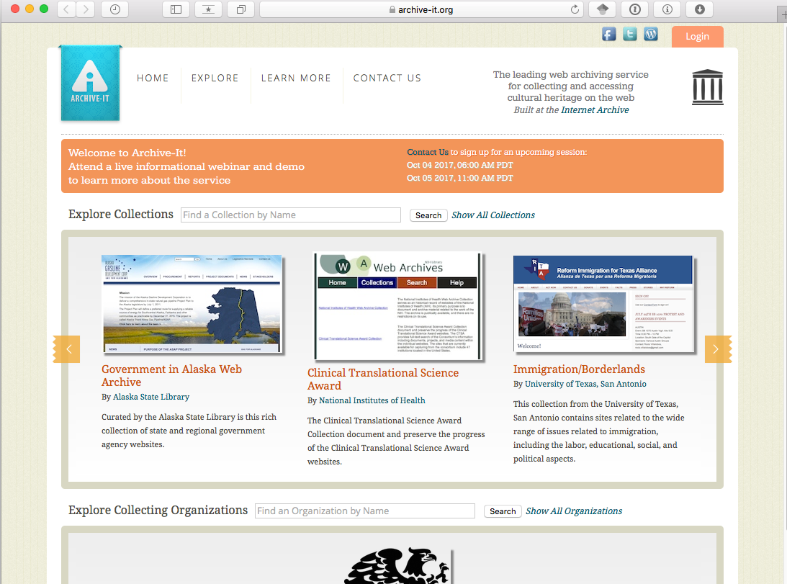
Archive-It – archive-it.org
Subscription service of the Internet Archive
400 partners
48 US states
16 countries
Partners include
College and University Libraries
State Archives, Libraries, and Historical Societies
Federal Institutions and NGOs
Museums and Art Libraries
Public Libraries, Cities and Counties

Slide 3
Collection Basics
Collections are a group of URLs curated around a common theme, topic, or domain.
Scope determines what the crawler will capture and what it won’t. Scoping is the process of, and use of tools, to tell the crawler how to adjust the scope. This includes general scoping, as well as scoping for specific web platforms.
Crawling is the use of software, called crawlers, to visit websites and index the information included therein.
Reviewing is the activity of evaluating completed captures.
Quality Assurance includes the use of tools and articles related to improving the quality of captures.
Access is the step of sharing content, by either making is publicly available, or sharing the private collection link, if applicable.
https://support.archive-it.org/hc/en-us/articles/115002187023-Archive-It-workflow

Slide 4
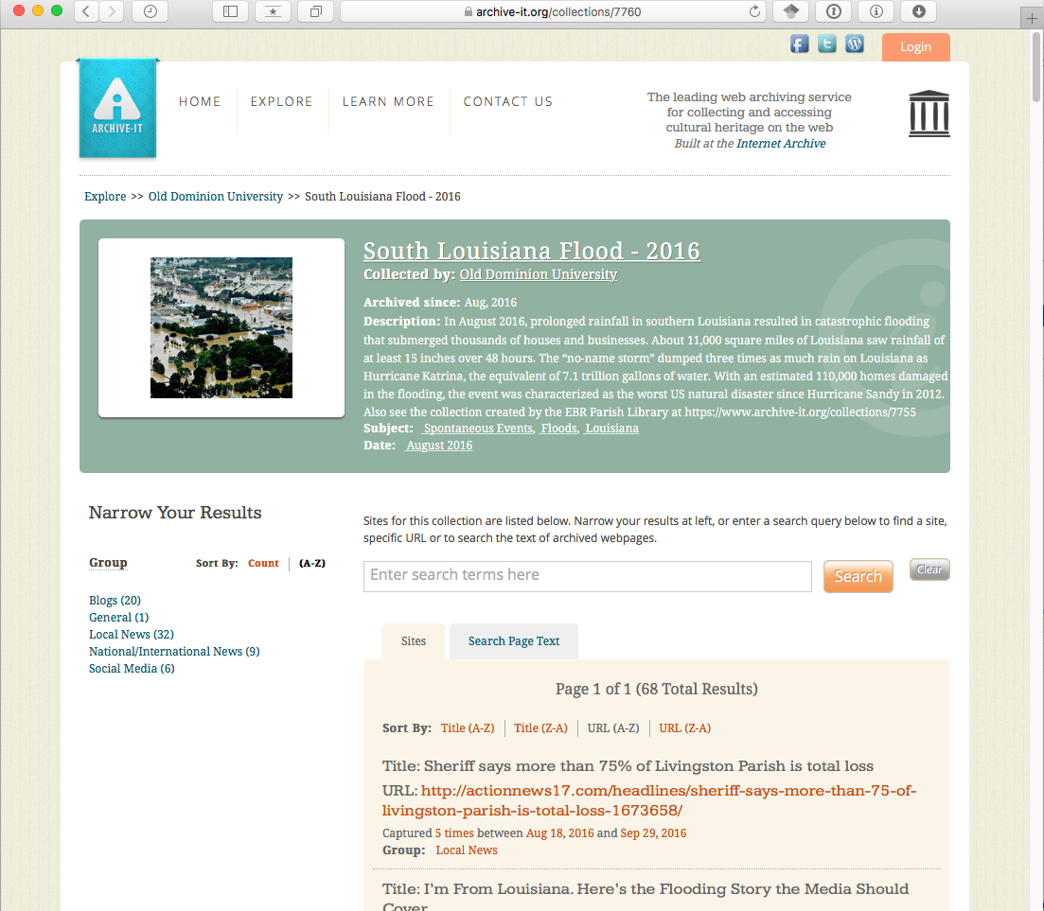
https://archive-it.org/collections/7760

Slide 5
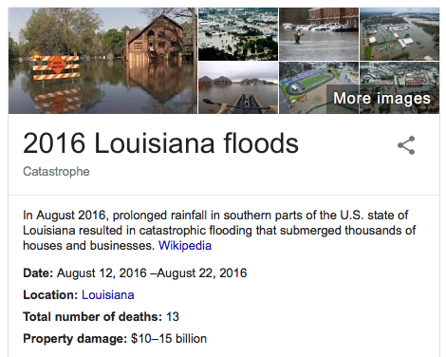
Why Did I Want To Create a Collection?

Slide 6
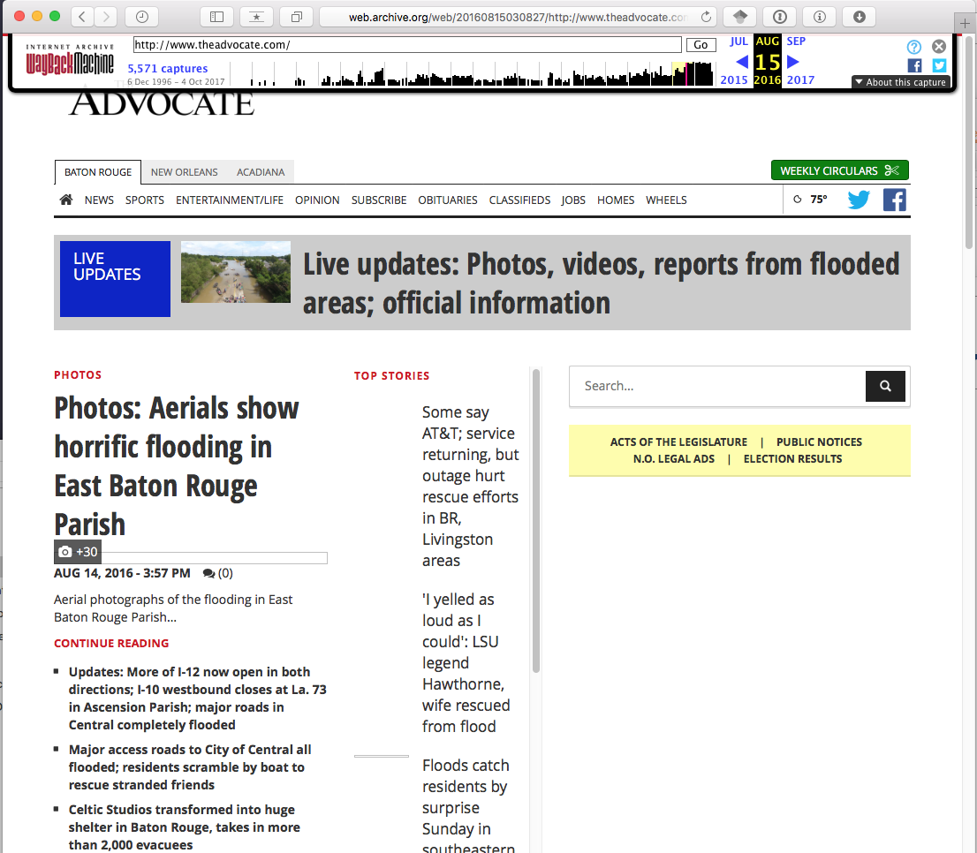
Baton Rouge Advocate / Aug 14, 2016

Slide 7
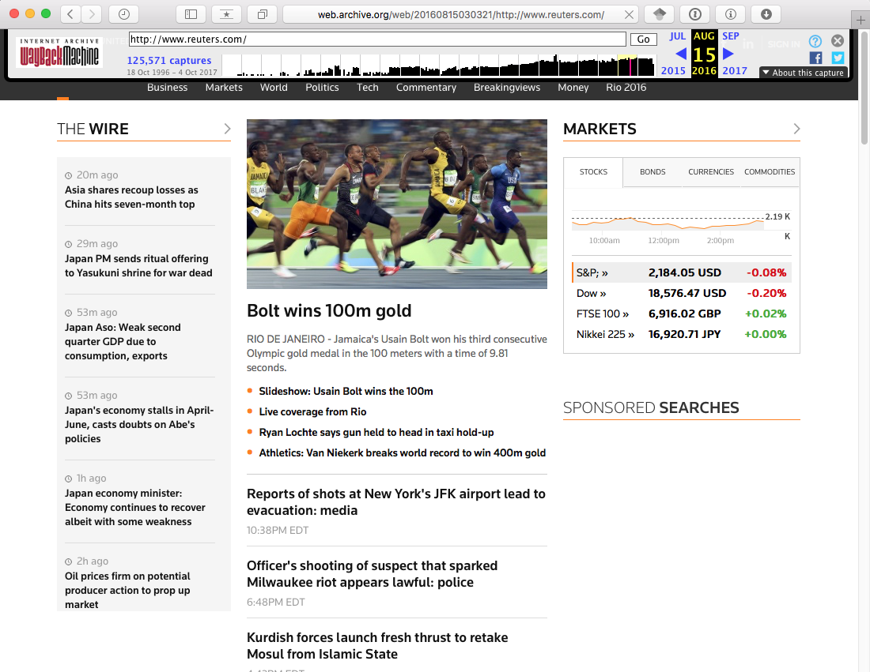
Reuters.com / Aug 14, 2016

Slide 8
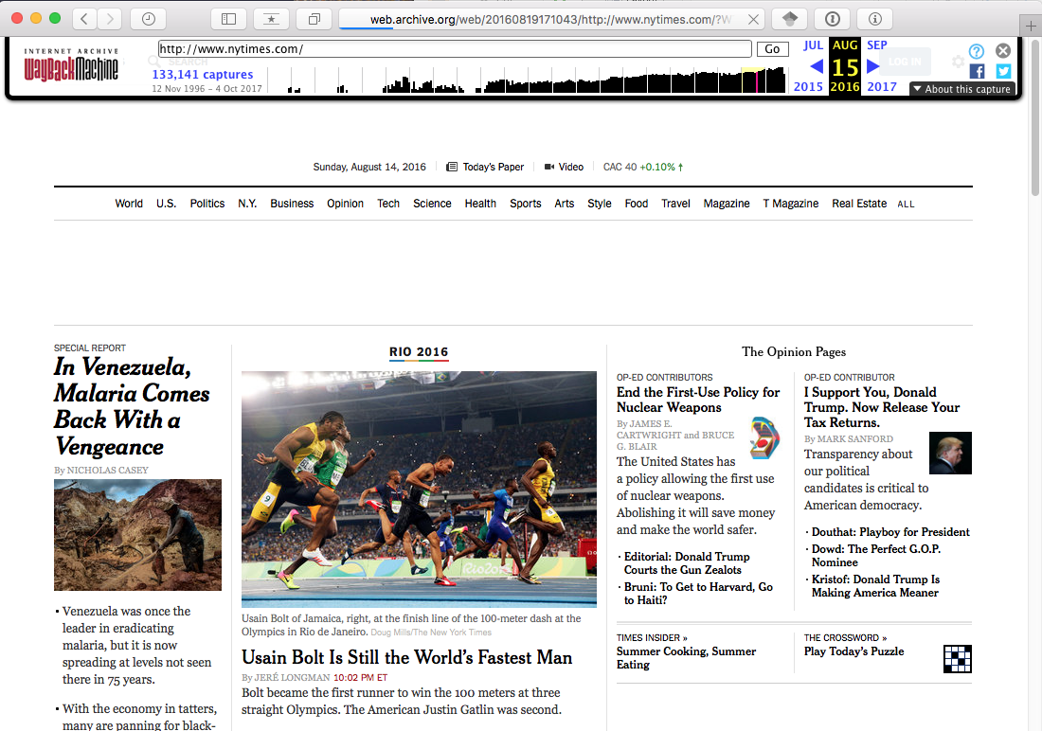
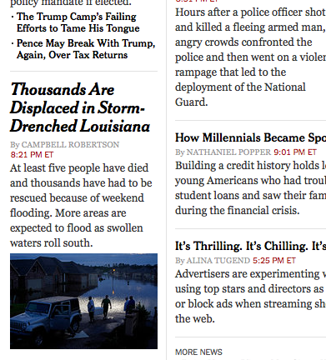
New York Times / Aug 14, 2016
Much farther down the page…

Slide 9
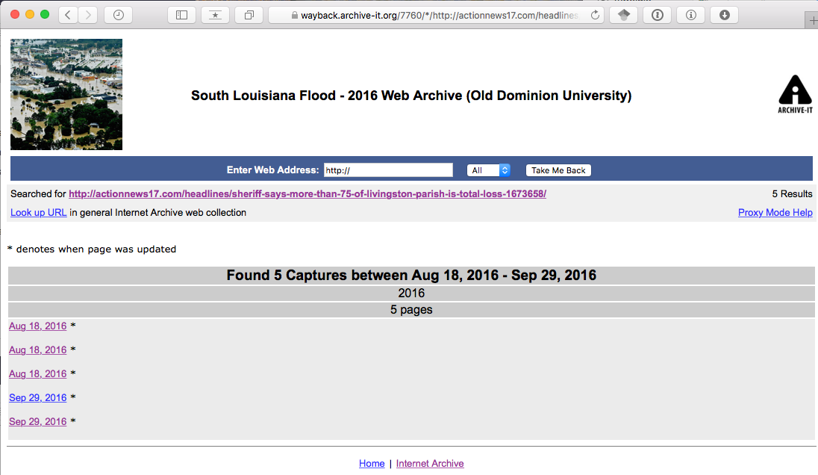
Capture Listing (old-style Wayback)

Slide 10
Walkthrough of the Collection
Pretty well-preserved - http://wayback.archive-it.org/7760/20160825224228/http://www.bbc.com/news/world-us-canada-37121404
Lots of damage, but text still available - http://wayback.archive-it.org/7760/20160818180320/http://www.actionnews17.com/headlines/sheriff-says-more-than-75-of-livingston-parish-is-total-loss-1673658
Captured more than just page-only - http://wayback.archive-it.org/7760/20160929184449/http://volunteerlouisiana.gov/
NY Times, list of recommended articles also preserved (provides context) - http://wayback.archive-it.org/7760/20160818180300/http://www.nytimes.com/2016/08/18/us/louisiana-flooding.html?_r=0
Flipagram (audio, pictures) not preserved - http://wayback.archive-it.org/7760/20160929184436/https://flipagram.com/f/mKQNY72zhI
Storify - captured ok, but not all images/tweets replayed - http://wayback.archive-it.org/7760/20160831174031/https://storify.com/NOLANews/when-floodwaters-rise/
Facebook, but no video - http://wayback.archive-it.org/7760/20160929185158/https://www.facebook.com/Walker.Police/videos/10155108364813368/#
Facebook – text-only post of first-hand account of what was going on during the flood - http://wayback.archive-it.org/7760/20160826124539/https://www.facebook.com/itsreininghorses/posts/10106070923387895/

Slide 11
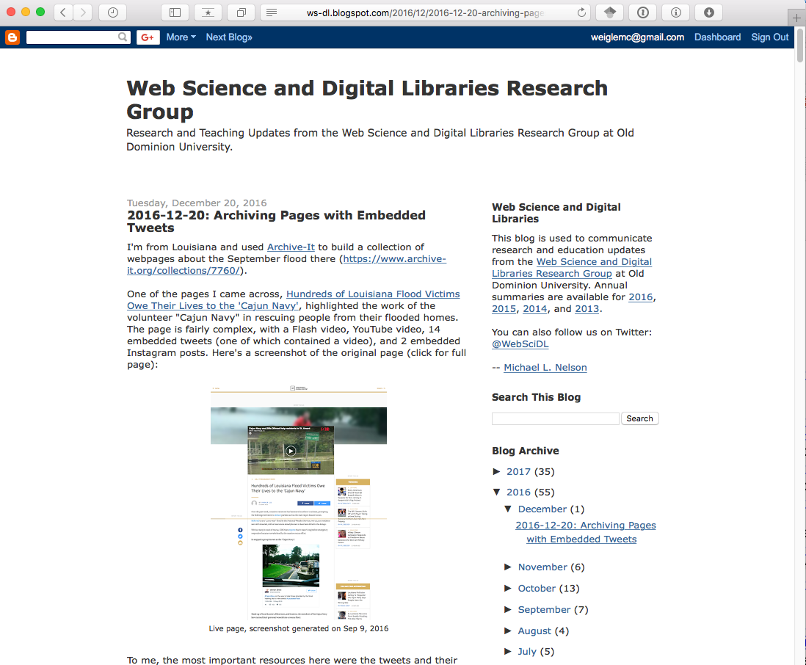
My Collecting Experience
http://ws-dl.blogspot.com/2016/12/2016-12-20-archiving-pages-with.html

Slide 12
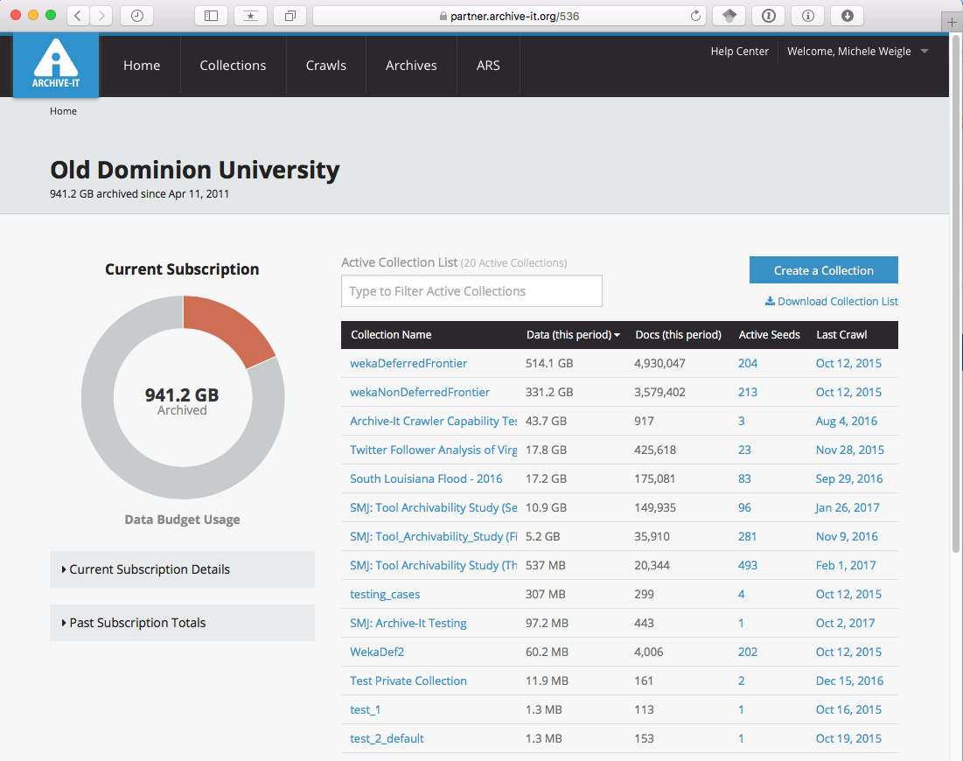
Backend – partner.archive-it.org

Slide 13
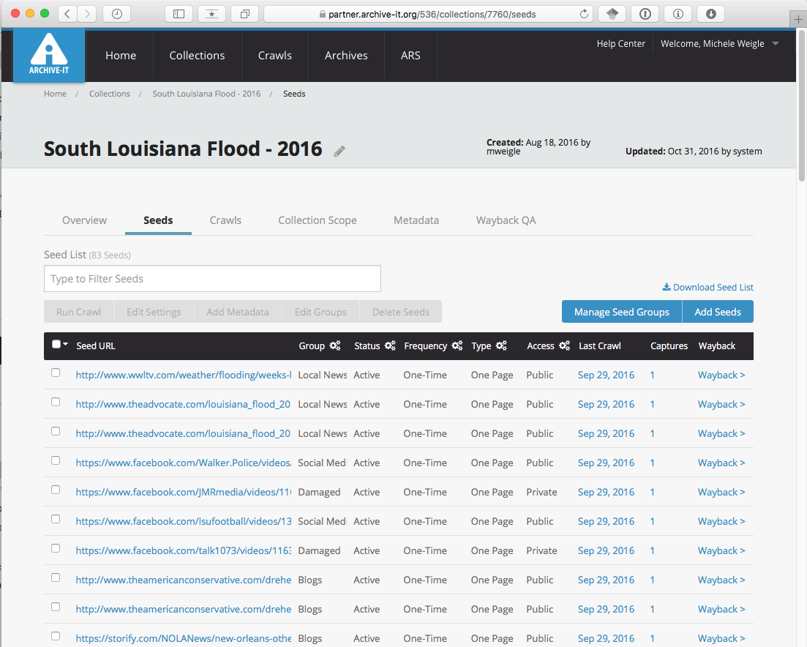
Seed List
Group
Status
Frequency
Type
Access
Last Crawl
Captures
Link to Wayback

Slide 14
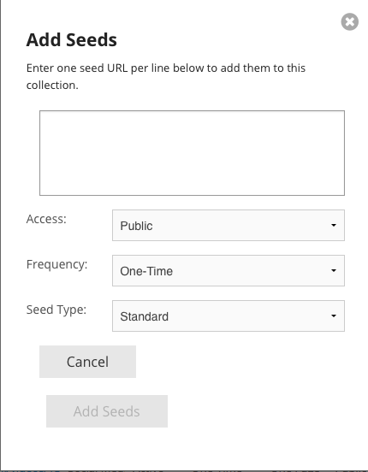
Add a Seed
Seed Types:
Default scope (Standard):
Embedded content captured
Linked content to internal pages captured
Linked content to external sites not captured
https://support.archive-it.org/hc/en-us/articles/208332843-Assign-and-edit-a-seed-type-

Slide 15
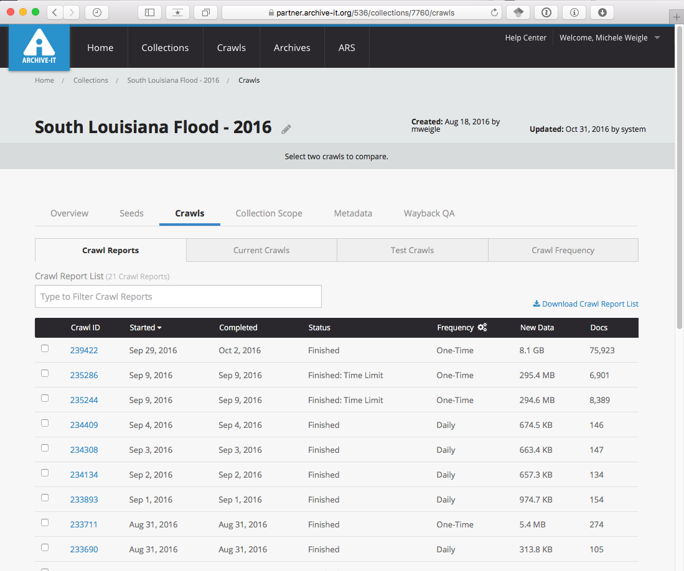

Slide 16
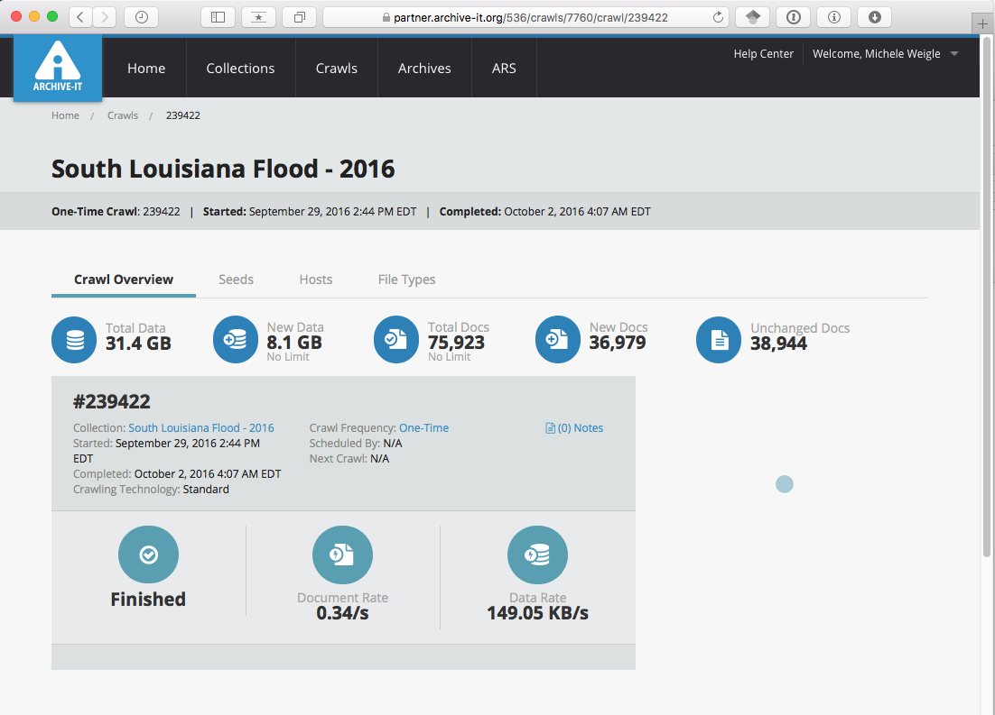

Slide 17
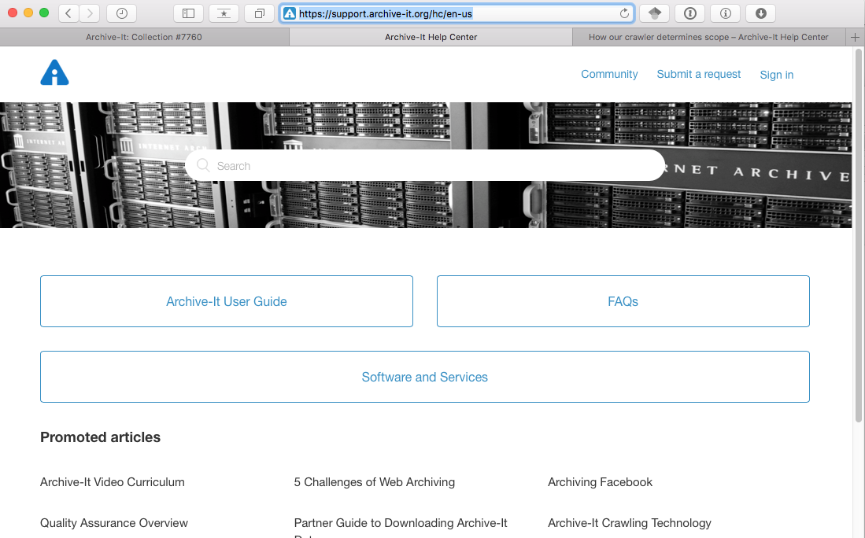
Help Center
https://support.archive-it.org/hc/en-us

Slide 18
Lots of Good Resources
User Guide - https://support.archive-it.org/hc/en-us/categories/201179946-Archive-It-User-Guide
Resources - https://support.archive-it.org/hc/en-us/sections/202143863-Resources
Archive-It Basics - https://support.archive-it.org/hc/en-us/articles/208111766-Archive-It-Trial-Basics
Archive-It Crawling Technology - https://support.archive-it.org/hc/en-us/articles/115001081186-Archive-It-Crawling-Technology
5 Challenges of Web Archiving - https://support.archive-it.org/hc/en-us/articles/209637043-5-Challenges-of-Web-Archiving
Archiving Facebook
https://support.archive-it.org/hc/en-us/community/posts/115010479146-Important-Update-
https://support.archive-it.org/hc/en-us/articles/208333113-Archiving-Facebook

